Slide 1


Cancer
Zackery Rogers, Luis Rojas, Hector Ladero, Akanksha Kukhraniya, Mariam Ahmad

Slide 2

Introduction
The last 50 years has seen a better understanding of the causes and treatments of cancer. Hence, the stigma, early detection and technology has improved the prognosis of cancer patients to unprecedented level.

Slide 3
Cancer Statistics
1.3 million new diagnoses cases every year
1 in 4 deaths from cancer
Early detection/Improvements in technology have improved prognosis

Slide 4
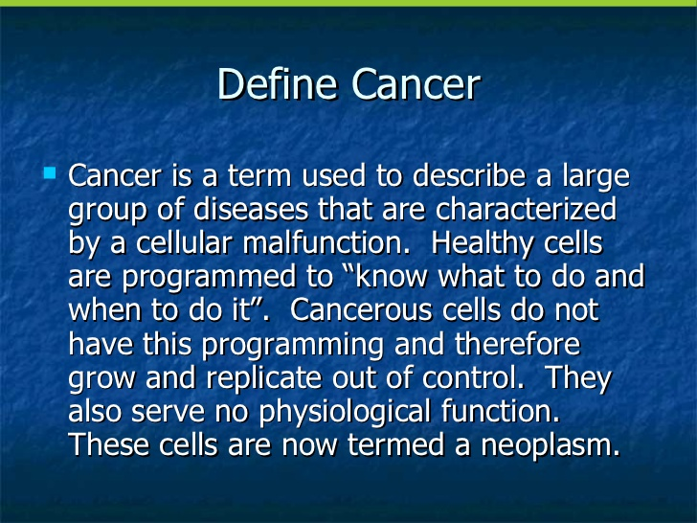
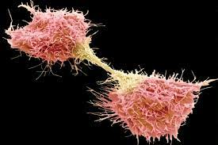

Slide 5
Types of Cancer
Carcinomas
Sarcomas
Lymphomas
Leukemias

Slide 6
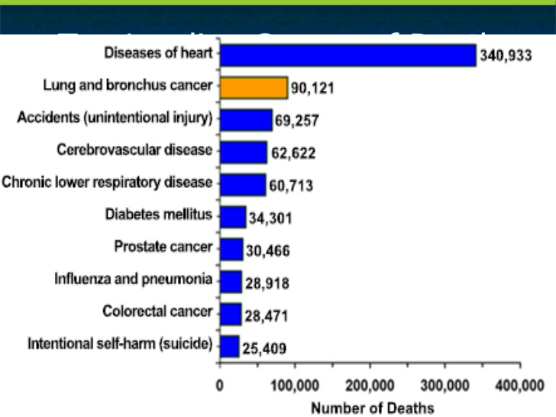

Slide 7
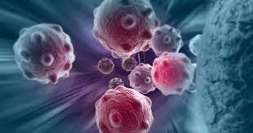
Overview of Cancer
Cellular change/ Mutation Theories
Spontaneous errors
External agents
Oncogenes
Risks for Cancer Lifestyle
Smoking among greatest
Nutrition/Exercise

Slide 8
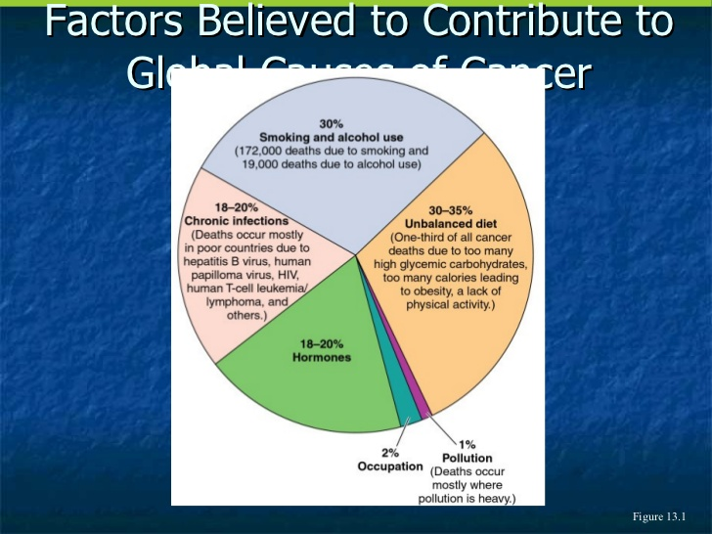

Slide 9
Types of Cancer
Breast Cancer
1 in 8 women
Risk with age
Risks factors supported by research
Prevention(Self-exam and mammogram)

Slide 10
Types of Cancer
Colon and rectum Cancer
3rd most common in men and women
Warning signs bleeding in the stool, rectal bleeding
Prostrate Cancer
Most common in Males today
Estimated 30,000 men will die
Skin Cancer
1.3 million cases
Treatable

Slide 11
Facing Cancer
Detecting Cancer
Magnetic Resonance Imaging (MRI)
Computerized Axial Tomography scanning (CAT)
Prostatic ultrasound (rectal probe)
Self exam and check ups

Slide 12
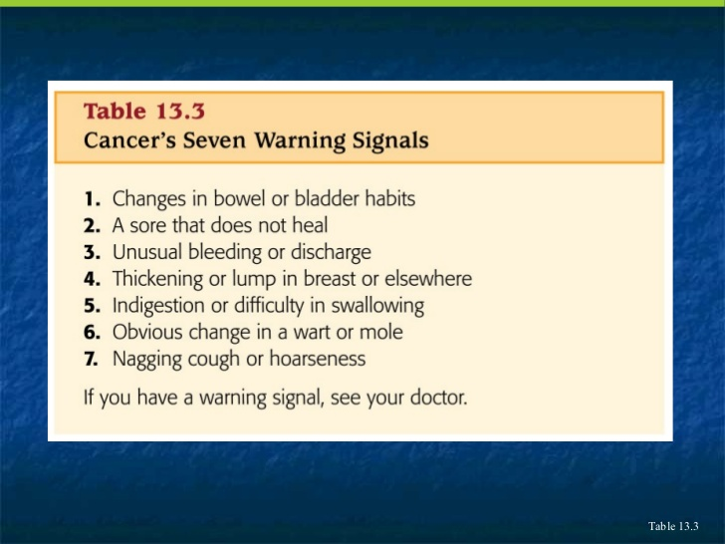

Slide 13
